Slide 1
Online Claims Entry UB-04
Conduent
Government Healthcare Solutions

Slide 2
Purpose
The purpose of this workshop is to provide an overview of the UB-04 direct data entry claims submission process. Having an understanding of UB-04 direct data entry submission via the New Mexico Medicaid Web Portal will improve billing practices by reducing claim denials and ensuring all rendered services are billed properly.

Slide 3
Objectives
Review the following processes regarding UB-04 claim submissions:
Claim Form Instructions
Timely Filing
New Hospital Outpatient Payment Method
Add/Manage Templates
Medicaid Primary Claims
Medicaid (TPL) Third Party Liability and PPO/HMO Claims
Medicare Replacement Plans
Medicare Primary Claims
Notes:
To effectively transition paper billers to electronic submission.

Slide 4
Getting Access to Bill on the Web Portal
If you are currently not registered on to the New Mexico Medicaid Web Portal you can create an account using either your active New Mexico Medicaid Provider ID or your NPI using the following link: https://nmmedicaid.portal.conduent.com/webportal/webRegistration/webRegStart
If your New Mexico Provider ID or NPI is currently registered on the New Mexico Medicaid Web Portal but you do not have access to log in to the Web Portal please contact your Master Administrator.
If you do not know if your Provider ID or NPI is registered on the New Mexico Medicaid Web Portal or if you do not know who your Master Administrator is, you can contact the HIPAA Helpdesk for further assistance at 1-800-299-7304 option 6, followed by option 4 or by email at HIPAA.Desk.NM@Conduent.com.

Slide 5
Claim Form Instructions
Conduent
Government Healthcare Solutions

Slide 6
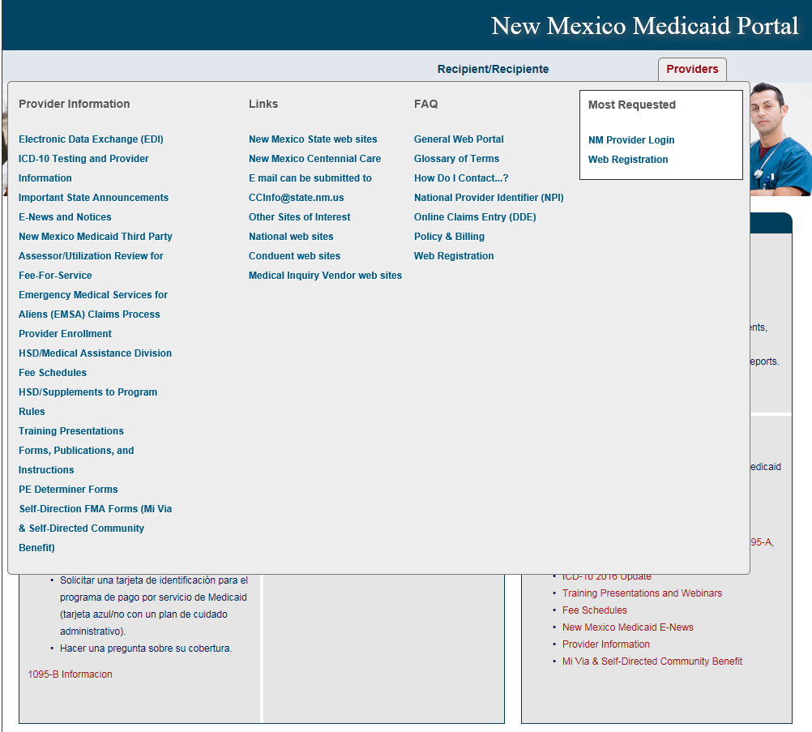
Where Do I Get a Copy of Claim Form Instructions?
On the WEB PORTAL: Click Providers then Forms, Publications, and Instructions under Provider Information
Continued on next screen…

Slide 7
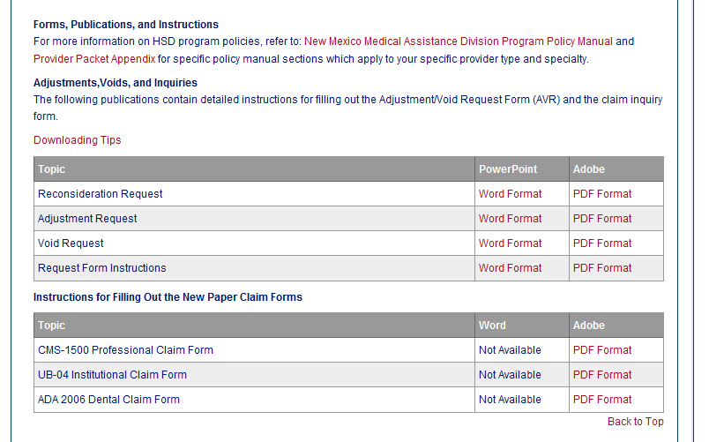
Where Do I Get a Copy of Claim Form Instructions?
Scroll down
Open file

Slide 8
What is a Transaction Control Number (TCN)?
91704900085000001
The twelfth digit in an adjustment/ void TCN will either be:
1= Debit
2= Credit
The first digit indicates what the claim “media” is:
2 = electronic crossover
3 = other electronic claim
4 = system generated claim or adjustment
8 = paper claim
9 = Web portal claim entry
Batch number
The last two digits of the year the claim was received
The numeric day of the year.
The claim number within the batch.
This is the Julian Date - this represents the date the claim was received by Conduent: this claim was received the 49th day of 2017, or February 18, 2017
Notes:
Global slide

Slide 9
Timely Filing
Conduent
Government Healthcare Solutions

Slide 10
Timely Filing
The information for Timely Filing is found on page 4 under the 8.302.2.11 portion section A. (3):
http://www.hsd.state.nm.us/uploads/files/Providers/New%20Mexico%20Administrative%20Code%20Program%20Rules%20and%20Billing/NMAC%20Program%20Rules/Chapter%20302/8_302_2(3).pdf
The rule can also be accessed via: http://www.hsd.state.nm.us/providers/rules-nm-administrative-code-.aspx

Slide 11
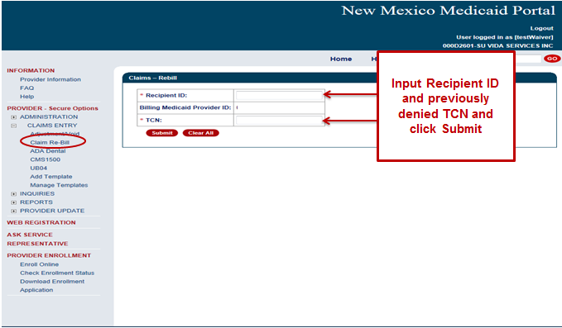
Timely Filing
Re-billing Claims can be done via the NM Web Portal only with claims that were originally submitted via the Portal.
To re-bill a denied claim, click Claim Re-bill under “Claims Entry” when you are logged in to your account.
Re-billing allows you to submit a corrected claim for a denied claim as long as the re-billed claim is submitted within 90 days from the denial of the original claim, not to exceed 210 calendar days from the date of service. When re-billing, you will need to use the TCN from your original claim as your proof of timely filing.
Notes:
If you have claims that were submitted within the 90 day limit from the primary insurance’s payment date but denied for timely filing due to the 210 day final filing limit policy AND you have proof the claims were submitted to the primary insurance within 90 days of the date of service AND either a delay in processing the claim or appeals and reconsideration requests caused the claim to exceed the 210 day final filing limit the claims can be resubmitted with a reconsideration request.

Slide 12
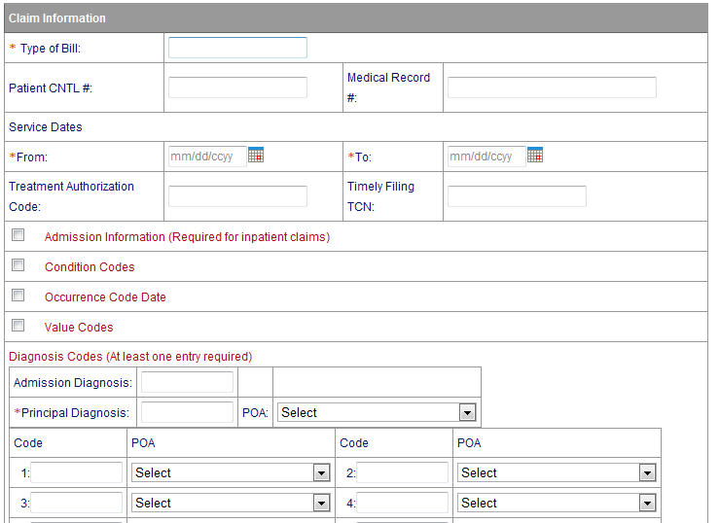
Timely Filing
Indicate the TCN in the “Timely Filing Justification – Prior TCN Number” field.
0001
1
1
082807
8,100 00
MEDICAID
123456789
CONNIE CLIENT

Slide 13
New Hospital Outpatient Payment Method
Conduent
Government Healthcare Solutions

Slide 14
Hospital Outpatient Payment Method for New Mexico Medicaid
All General Acute Hospitals and Rehabilitation Hospitals must include a procedure code on every line item to receive payment.
It is recommended that you bill all outpatient services for the same date of service on the same claim form all inclusive.

Slide 15
New Hospital Outpatient Payment Method for New Mexico Medicaid
The following resources are available on the HSD/MAD website located at:
New Mexico Medicaid Fee Schedules
Hospital Outpatient Payment Method FAQ
Hospital Outpatient Payment Method Revenue Codes
Hospital Outpatient Payment Method Procedure Codes
Notice of Hospital Outpatient Prospective Payment System Rates
Explanation of Simulation Spreadsheet for Outpatient services

Slide 16
Add/Manage Templates
Conduent
Government Healthcare Solutions

Slide 17
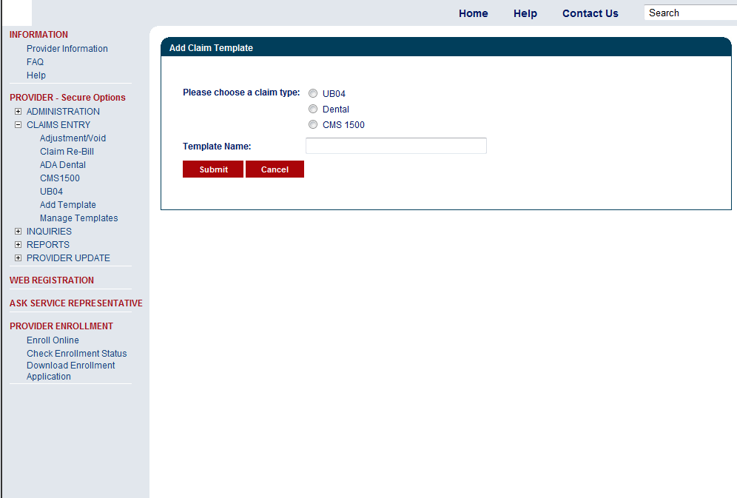
UB-04 Add Claim Template
Please note creating templates are limited to 25 per user.
The best time to directly enter your claim is Sunday through Friday between the hours of 6 a.m. - 6 p.m. (MST). Claims entered by Friday 6 pm could be adjudicated and reflect as early as Monday on your Remittance Advice.

Slide 18
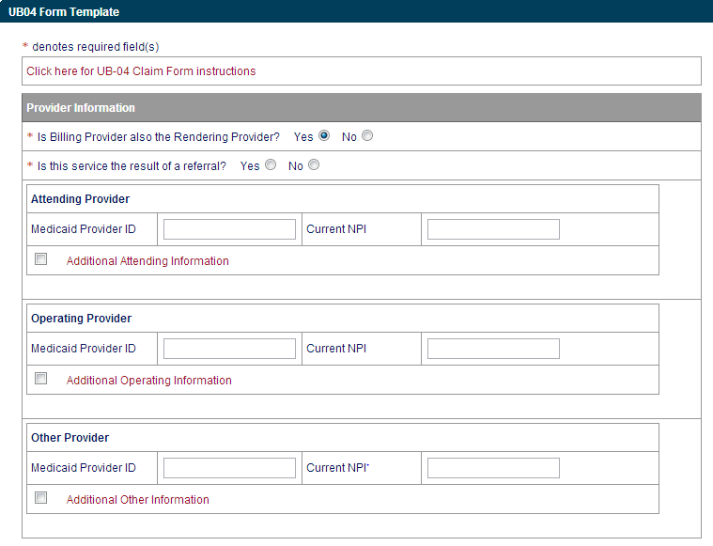
UB-04 Add Claim Template
Fill out any information you would like included in your template

Slide 19
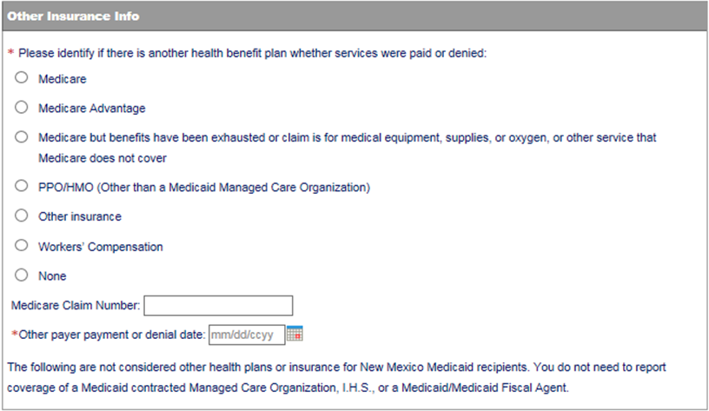
UB-04 Add Claim Template
Fill out any information you would like included in your template

Slide 20
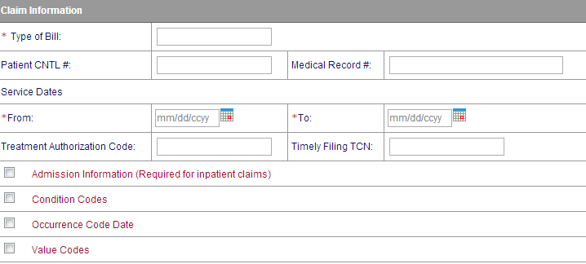
UB-04 Add Claim Template
Fill out any information you would like included in your template

Slide 21
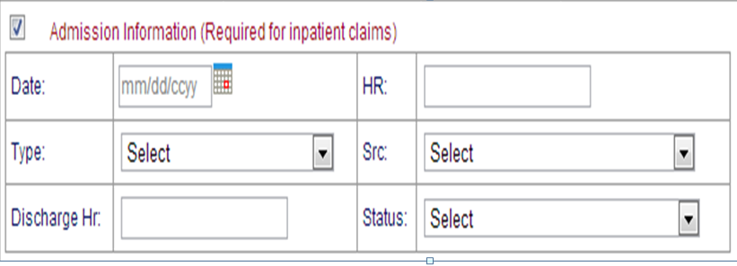
UB-04 Add Claim Template
Fill out any information you would like included in your template.
Sections can be expanded by checking all sections with Red Text. View next slide for additional fields.

Slide 22
UB-04 Add Claim Template
Fill out any information you would like included in your template.
Sections can be expanded by checking all sections with Red Text.

Slide 23
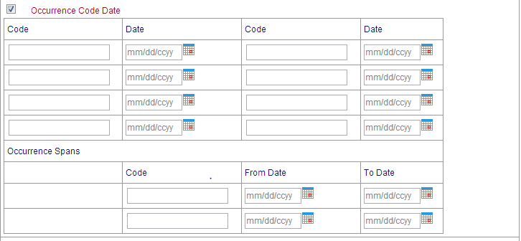
UB-04 Add Claim Template
Fill out any information you would like included in your template.
Sections can be expanded by checking all sections with Red Text.

Slide 24
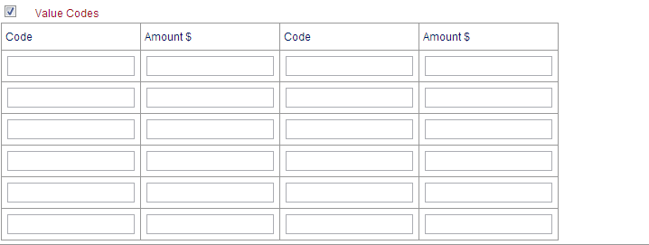
UB-04 Add Claim Template
Fill out any information you would like included in your template.
Sections can be expanded by checking all sections with Red Text.

Slide 25
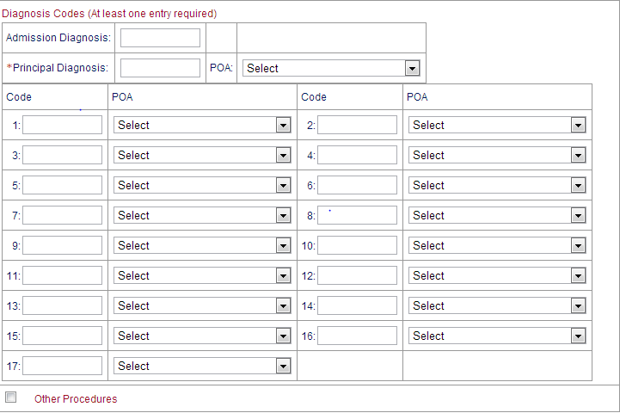
UB-04 Add Claim Template
Decimal point is not required for diagnosis. Using a decimal point will result in the error message below.
“Diagnosis Code must be at least three alphanumeric characters and cannot include decimals.”
Fill out any information you would like included in your template.
Sections can be expanded by checking all sections with Red Text.
Notes:
System will automatically input decimal point.

Slide 26
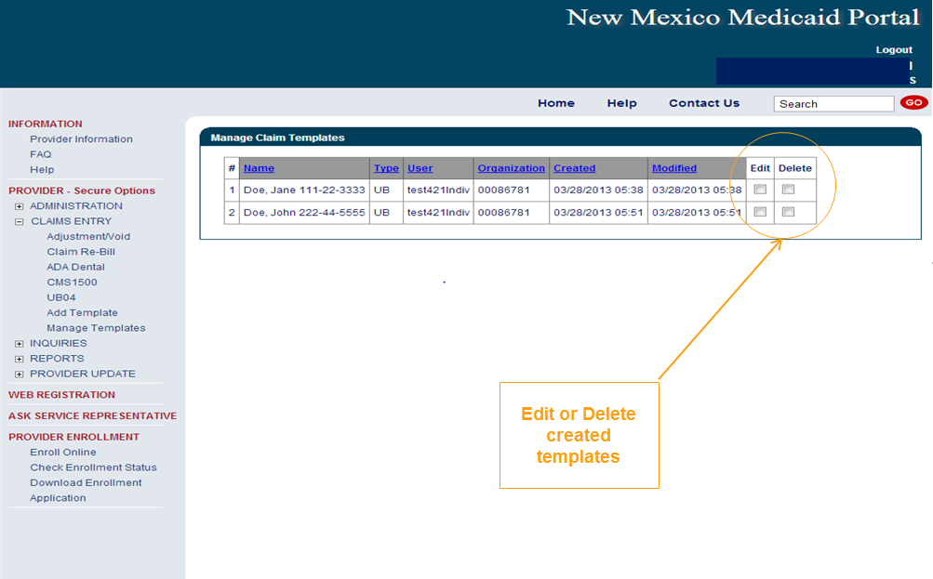
UB-04 Manage Claim Template

Slide 27
Medicaid Primary Web Portal Claim Submission
Conduent
Government Healthcare Solutions

Slide 28
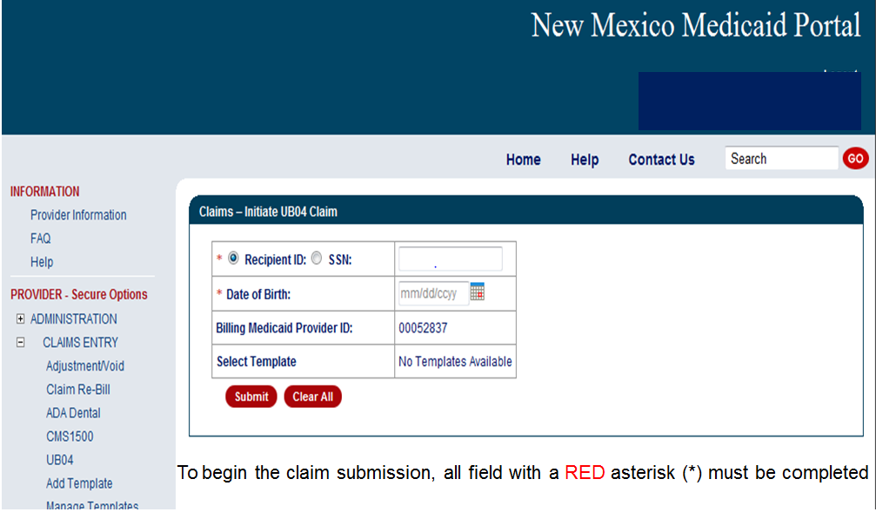
Online Claims Entry

Slide 29
Online Claims Entry Primary Claim Continued
Click on the Red Text for the UB-04 Claim form instructions
Notes:
**Screenshot needed of Claim Form Instructions Box**

Slide 30
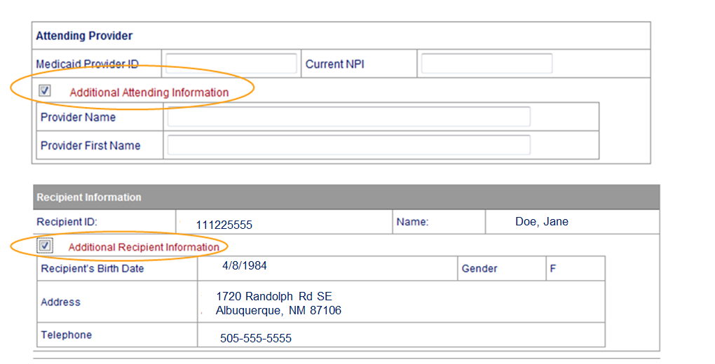
Additional Information Option
Sections can be expanded by selecting all sections with Red Text

Slide 31
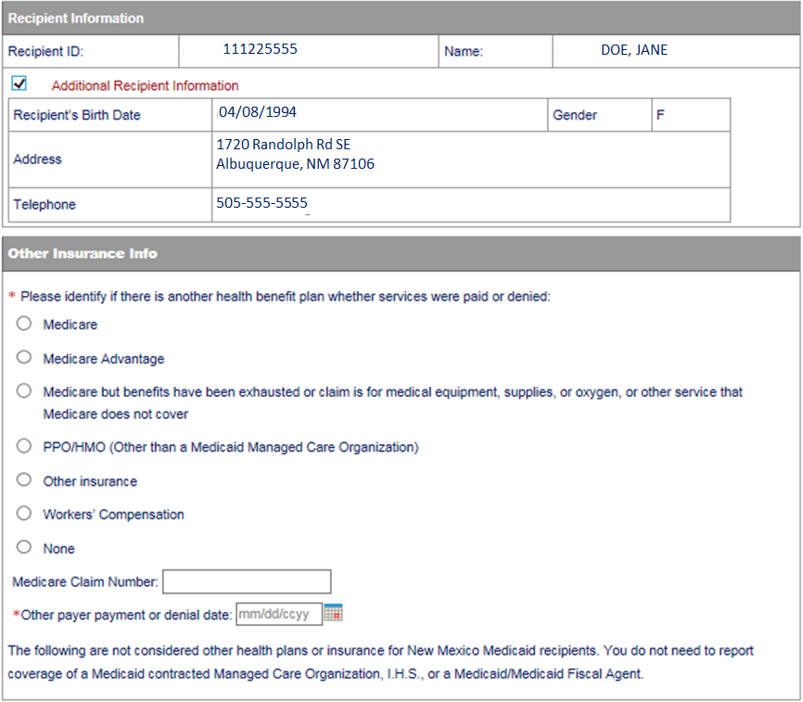
Online Claims Entry Primary Claim Continued
Select “None” since no other insurance is involved.

Slide 32
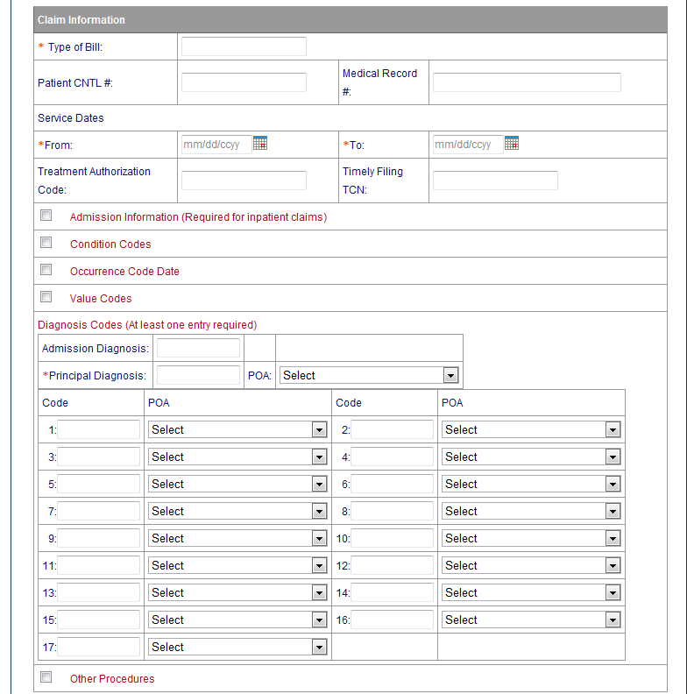
Online Claims Entry Primary Claim Continued
Sections can be expanded by selecting all sections with Red Text

Slide 33
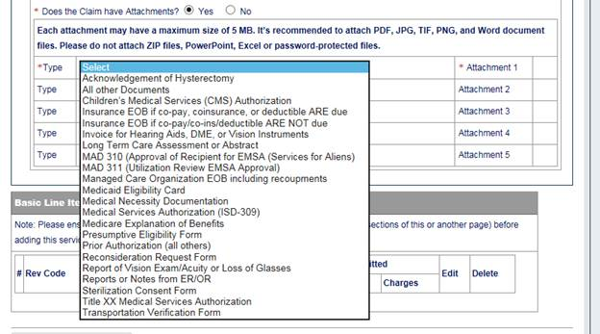
Online Claims Entry -- Attachments

Slide 34
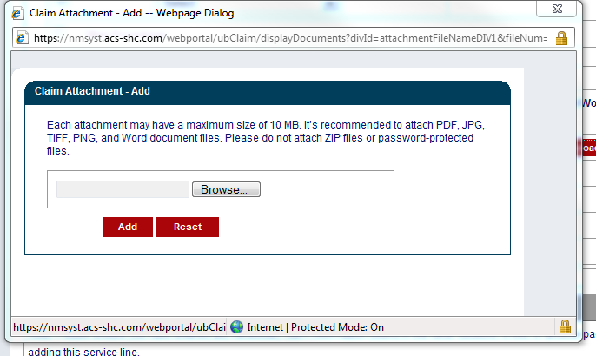
Online Claims Entry Primary Claim Continued
Review the Uploading Attachments Restrictions.
You can attach files up to 10 MB
Do not upload ZIP Files, Excel Spreadsheets or Password Protected Files.
PDF, JPG, TIFF, and Word Documents files are recommended

Slide 35
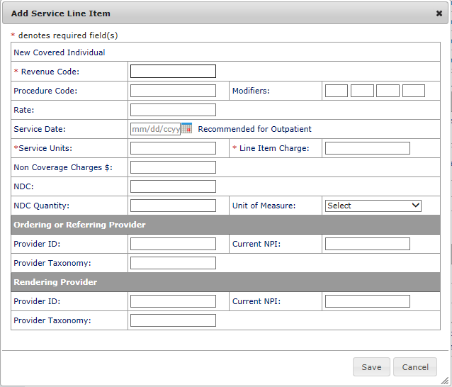
Online Claims Entry Primary Claim Continued
All field with a Red Asterisk (*) are REQUIRED fields

Slide 36
Online Claims Entry Primary Claim Continued
Indicate the Total charge. Must match Rev Code 0001 which is the last line item on the claim
Indicate the Amount Due
x
Verify Total charge is correct
If total charge is missing or does not equal the total of all line charges provided on the claim, the claim will deny or post additional edits.

Slide 37
TPL, HMO and PPO Web Portal Claim Submission
Conduent
Government Healthcare Solutions

Slide 38
Third Party Liability (TPL) Tips
TPL is commercial insurance
TPL must be billed primary to Medicaid
Medicaid does not consider Medicare TPL
Notes:
What does PEDS stand for?

Slide 39
Other Primary Insurance Tips
If Medicaid requires a Prior Authorization (PA) for the service, then a PA issued by the Medicaid Third Party Assessor is always required when TPL is involved, no matter if TPL paid or denied the service.
Attach the TPL EOB showing the payment/denial with the claim.
Always include the explanation page of the EOB along with the page of the EOB that shows payment/denial.
PPO/HMO claims are billed identically to “other insurance” (TPL) claims.
Notes:
What does PEDS stand for?

Slide 40
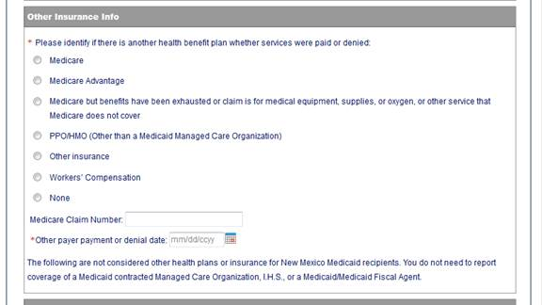
TPL, HMO, and PPO Web Portal Claim Submission
When filling out a Medicaid claim indicate whether the Primary Insurance us a PPO/HMO or other insurance by selecting the appropriate option
When filling out a Medicaid claim where TPL is primary payer, be sure to fill in all required primary and secondary payer information

Slide 41
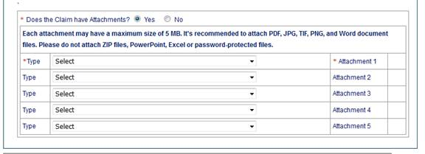
Claims Information – Attachments
Attach a copy of the EOB
along with the explanation
of denials page

Slide 42
Medicaid TPL Claim Example
Indicate the Total charge. Must match Rev Code 0001 which is the last line item on the claim
TPL Payment
Co-pay/Co-insurance/Deductible
x
Verify Total charge is correct
If total charge is missing or does not equal the total of all line charges provided on the claim, the claim will deny or post additional edits.

Slide 43
Medicaid Co-Payment Web Portal Claim Submission
Conduent
Government Healthcare Solutions

Slide 44
PPO/HMO Co-Pay Tips
Indicate PPO/HMO under “Other Insurance Info” section of the claim.
Attach the EOB.
Enter the co-payment amount in the “Amount Due” field.

Slide 45
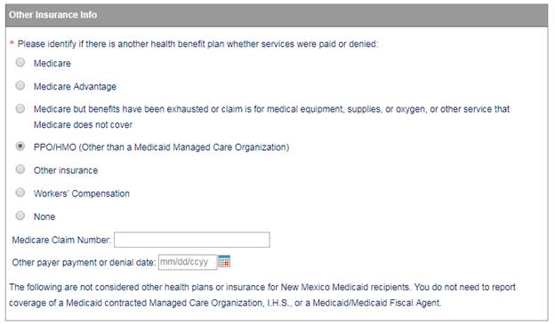
PPO/HMO Co-pay Claim
Notes:
Total commercial insurance portion will no longer be here. New screenshot for this page

Slide 46
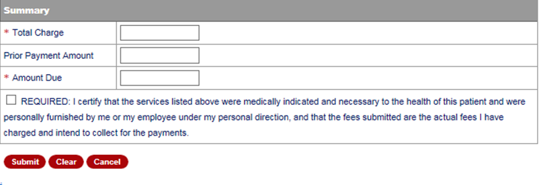
PPO/HMO Co-pay Claim
Indicate the Total charge. Must match Rev Code 0001 which is the last line item on the claim
Difference
Co-pay/Co-insurance/
Deductible
x
Verify Total charge is correct
If total charge is missing or does not equal the total of all line charges provided on the claim, the claim will deny or post additional edits.

Slide 47
Medicare Replacement Plan Web Portal Claim Submission
Conduent
Government Healthcare Solutions

Slide 48
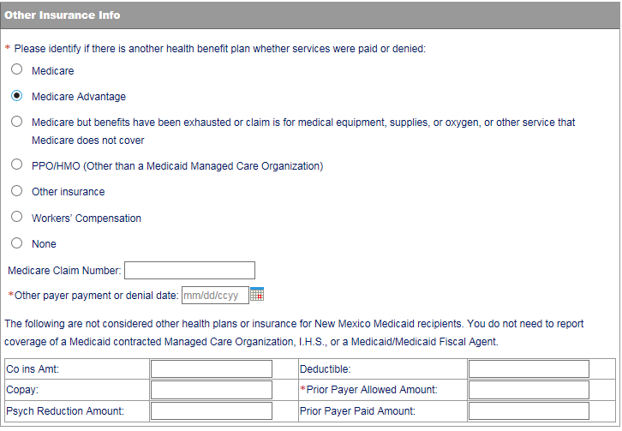
Medicare Replacement Plan
Indicate “Medicare Advantage” for Medicare Replacement Plan

Slide 49
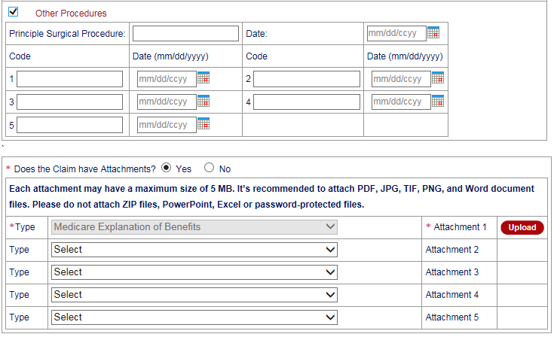
Medicare Replacement Plan
Attach Copy of EOB

Slide 50
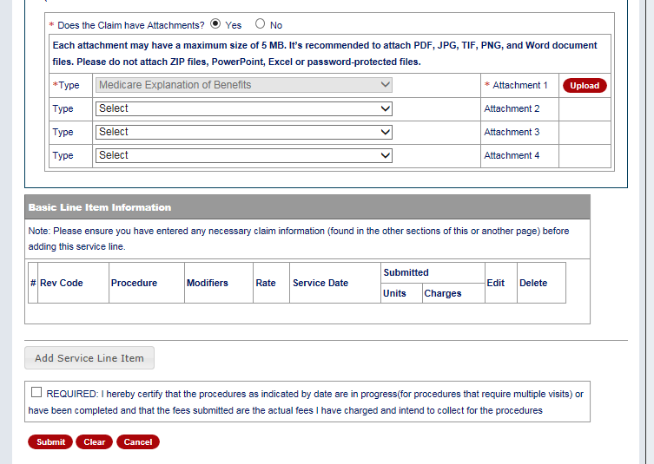
Medicare Replacement Plan

Slide 51
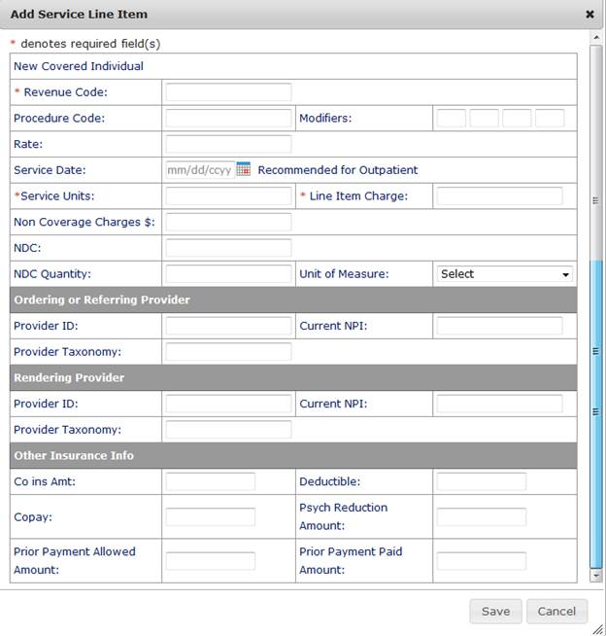
Medicare Replacement Plan
Other Insurance Information can be input at the line item level here

Slide 52
Medicare Primary Web Portal Claim Submission
Conduent
Government Healthcare Solutions

Slide 53
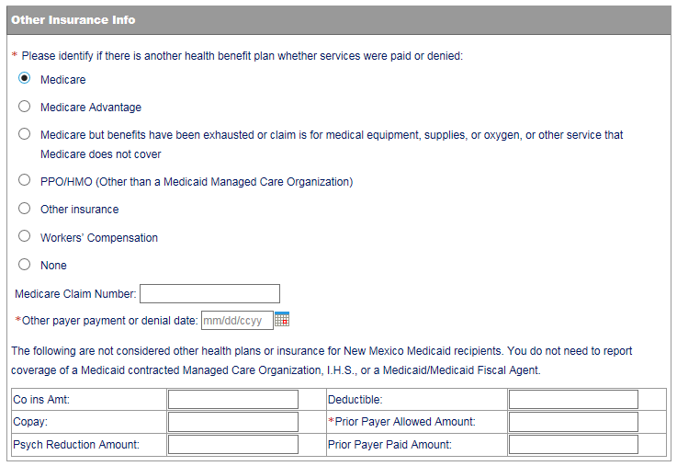
Medicare Primary Claims
Indicate “Medicare” for Medicare Crossover submissions

Slide 54
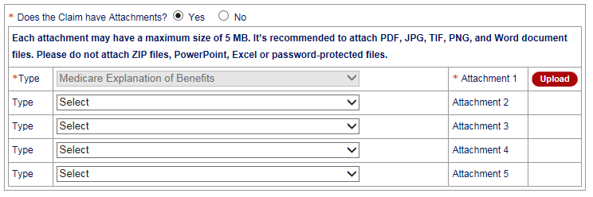
Medicare Primary Claims
Attach a copy of the EOB

Slide 55
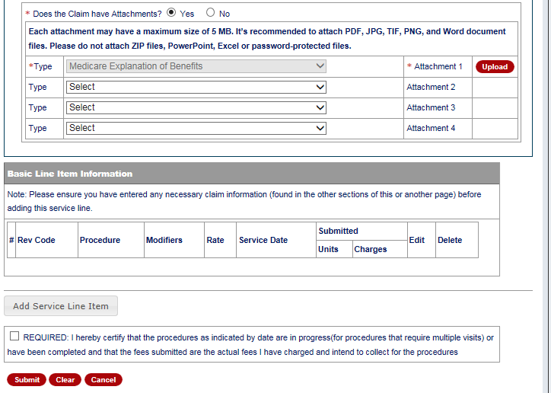
Medicare Primary Claims

Slide 56
Medicare Primary Claims
Other Insurance Information can be input at the line item level here

Slide 57
Inpatient Claims for Medicare Part B Only Clients
Conduent
Government Healthcare Solutions

Slide 58
Inpatient Claims for Medicare Part B-Only Clients
Certain Medicaid/Medicare clients only have Medicare Part B coverage. Medicare may cross over the Part B claim with type of bill 121. This claim does not have an accommodation revenue code on it. The claim will deny and the provider will need to resubmit and include the following on the claim:
Use type of bill “121”
Attach a copy of the EOMB indicate Medicare paid amount in previous payment box (form locator 54).
Notes:
What does PEDS stand for?

Slide 59
Inpatient Claims for Medicare Part B-Only Clients
Indicate “Medicare” for Inpatient Claims for Medicare Part B-Only Recipients

Slide 60
Inpatient Claims for Medicare Part B-Only Clients
Attach a copy of the EOB
along with the explanation
of denials page

Slide 61
Inpatient Claims for Medicare Part B-Only Clients

Slide 62
Inpatient Claims for Medicare Part B-Only Clients
Other Insurance Information can be input at the line item level here

Slide 63
UB-04 Tips
Conduent
Government Healthcare Solutions

Slide 64
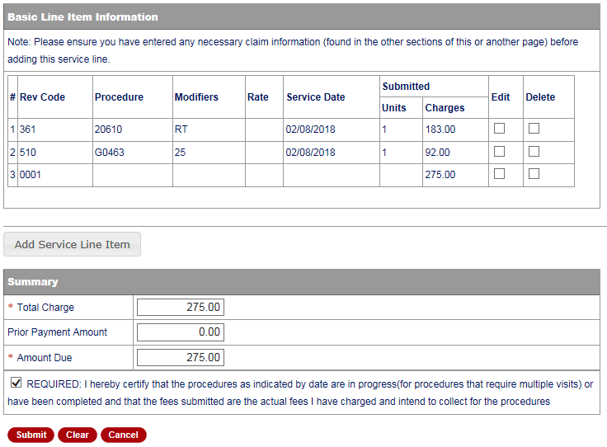
UB-04 Tips
Ensure the line item charges are correct and match the total charge.

Slide 65
Summary
Provided general billing guidelines for direct data entry submission of the UB-04 claim form for the below coverage scenarios.
Add/Manage Templates
Medicaid Primary Claims
Medicaid (TPL) Third Party Liability Claims
PPO/HMO Claims
Medicare Replacement Plan Claims
Medicare Primary Claims

Slide 66
New Mexico Medicaid Resources
New Mexico Medicaid Online
Provider Information
Provider Login Screen Notices
Provider E-News Newsletters
Medicaid Provider Relations Call Center
Provider Communication Updates
Provider Field Representative
Provider Webinars
Open Forums and Live Training Sessions

Slide 67
New Mexico Medicaid Resources Continued
New Mexico Medicaid Portal – https://nmmedicaid.portal.conduent.com/static/index.htm
Claim Inquiries, Eligibility Verification, Electronic Claim Submission, Provider Manuals, E-News
NM Human Services Department – http://www.hsd.state.nm.us/mad/
Supplements, Memos, Provider Billing Packets and Policy
Conduent Provider Relations Call Center – (800) 299 - 7304 option 6 or (505) 246 - 0710 option 6.
Claim Status, Eligibility, Prior Authorization, Medicaid Updates
Conduent Provider Relations Helpdesk – NMProviderSUPPORT@conduent.com
Claim research assistance and general Medicaid inquiries
Conduent HIPAA Helpdesk – HIPAA.Desk.NM@conduent.com Assistance on NM Web Portal, EDI inquiries, and Online Claim Submission with DDE (Direct Data Entry)
Conduent Provider Enrollment Helpdesk - NMProviderSUPPORT@conduent.com
Provider Enrollment Applications, Forms & Instructions
NM Medicaid Recipient Helpdesk – (888) 997 – 2583 or (505) 247 – 1042
Eligibility inquiries, Fee-for-Service Replacement Medicaid Identification Card, Enroll or change a Managed Care Organization and Eligibility application status
Medical Assistance Division, Program Rules – http://www.hsd.state.nm.us/providers/rules-nm-administrative-code-.aspx
NMAC for Programs administered by the Medical Assistance Division Yes New Mexico - https://www.yes.state.nm.us/yesnm/home/index Apply, check, update, or renew Medical Assistance (Medicaid) benefits

